Slide 1

Motivations….

Slide 2
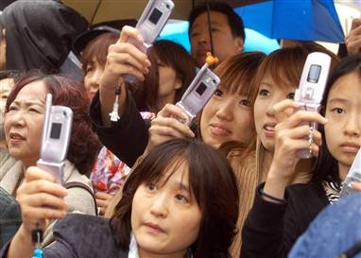
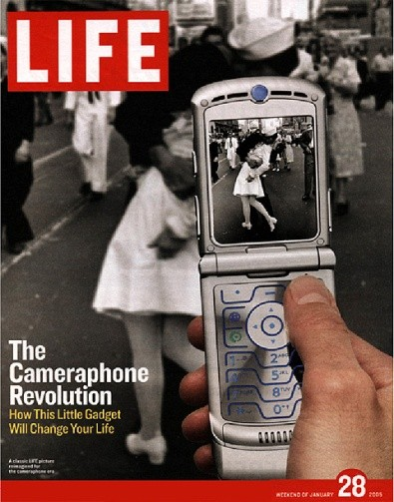
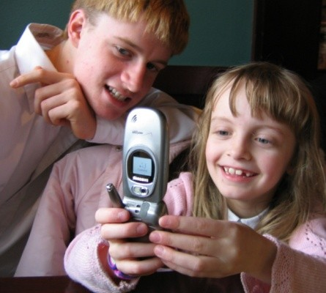
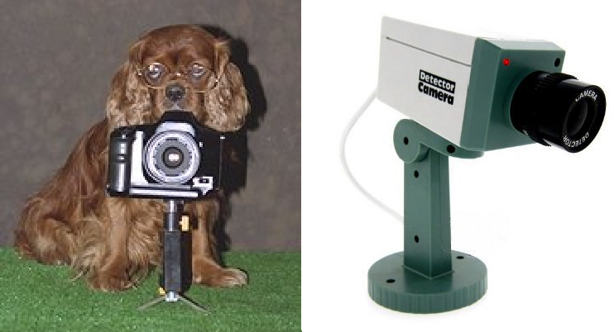
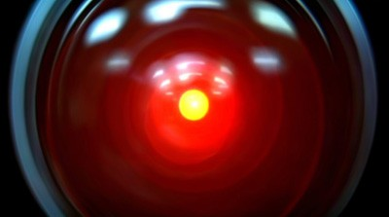
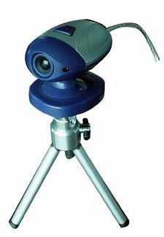
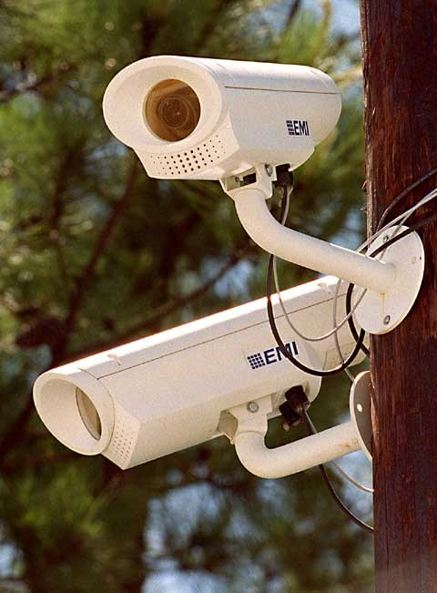
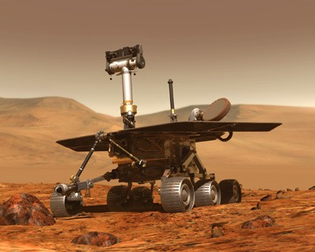
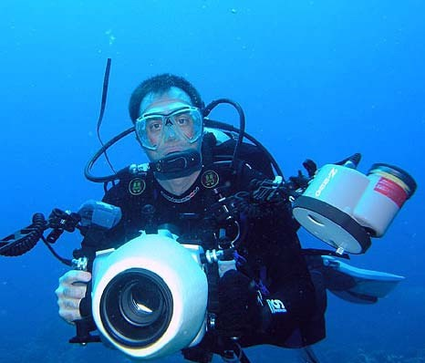
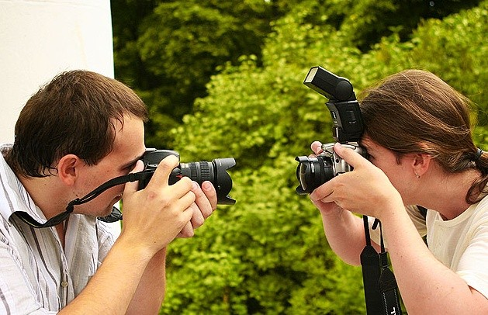
Playing with Pixels
Slides source: Fie Fie Li (Professor, Stanford)
Lecture 1 -

Slide 3
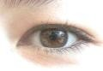
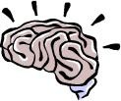
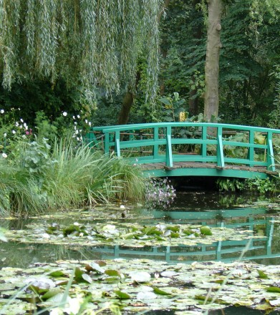
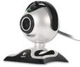
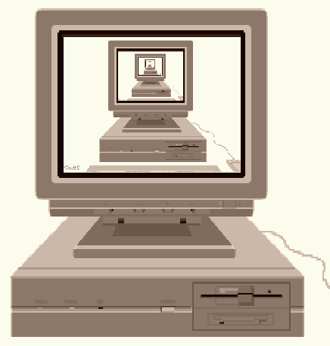
What is
(computer)
vision?
Image (or video)
Sensing device
Interpreting device
Interpretations
garden, spring, bridge, water, trees, flower, green, etc.
Slides source: Fie Fie Li (Professor, Stanford)

Slide 4
What is (computer) vision?
Image (or video)
Sensing device
Interpreting device
Interpretations
garden, spring, bridge, water, trees, flower, green, etc.
Slides source: Fie Fie Li (Professor, Stanford)

Slide 5
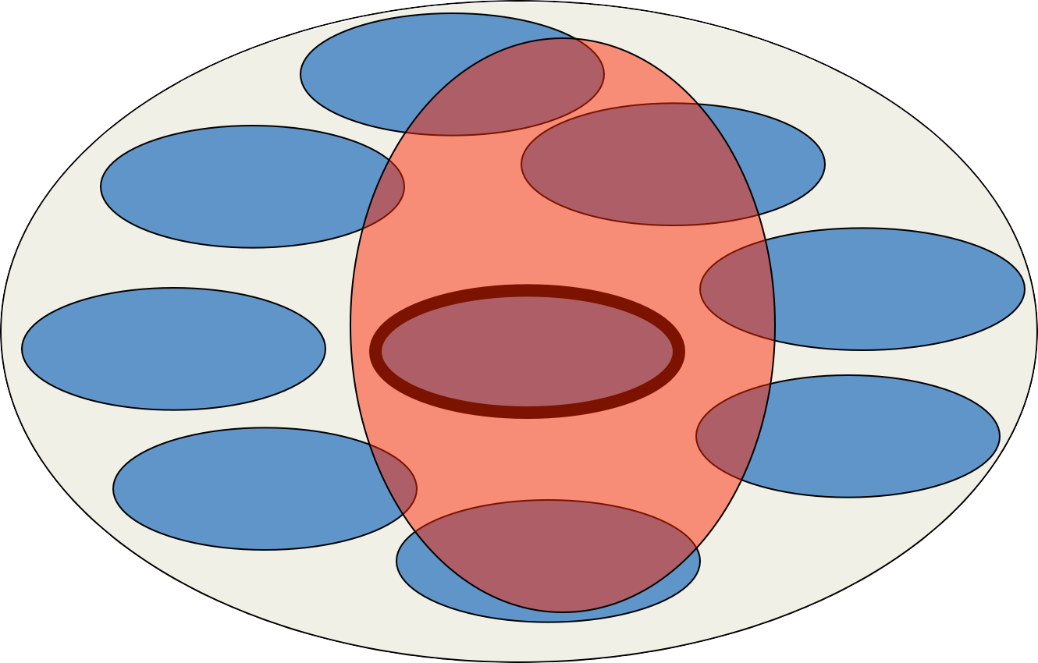
What is it related to?
Biology
Psychology
Neuroscience
Engineering
Cognitive sciences
Robotics
Computer Science
graphics,algorithms, system,theory,…
Speech
Computer Vision
Information retrieval
Image processing
Machine learning
Physics
Maths
Slides source: Fie Fie Li (Professor, Stanford)

Slide 6
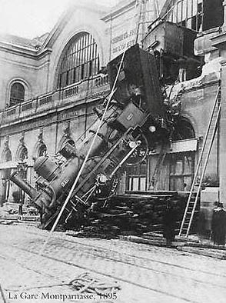
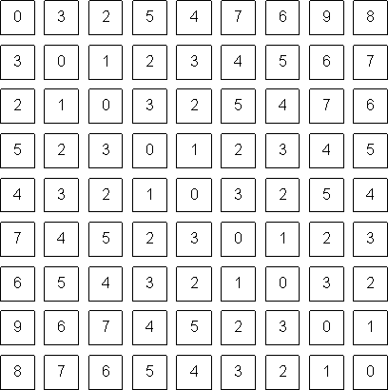
The goal of computer vision
To bridge the gap between pixels and “meaning”
What we see
What a computer sees
Slides source: Fie Fie Li (Professor, Stanford)

Slide 7
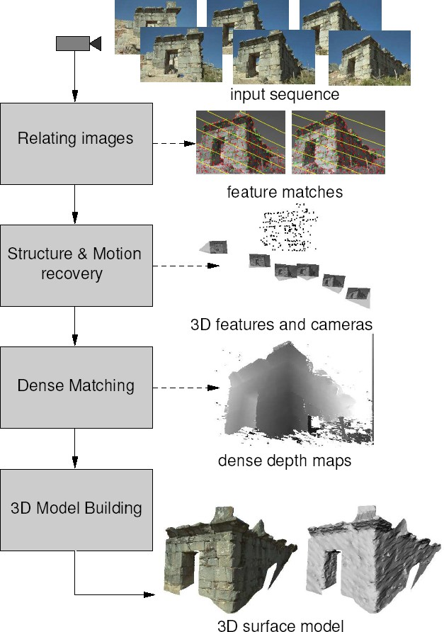
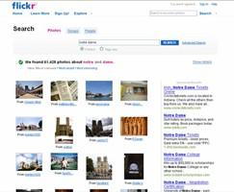
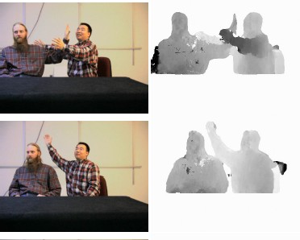
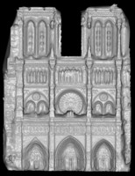
Vision as measurement device
ernet photo collections
Slides source: Fie Fie Li (Professor, Stanford)

Slide 8
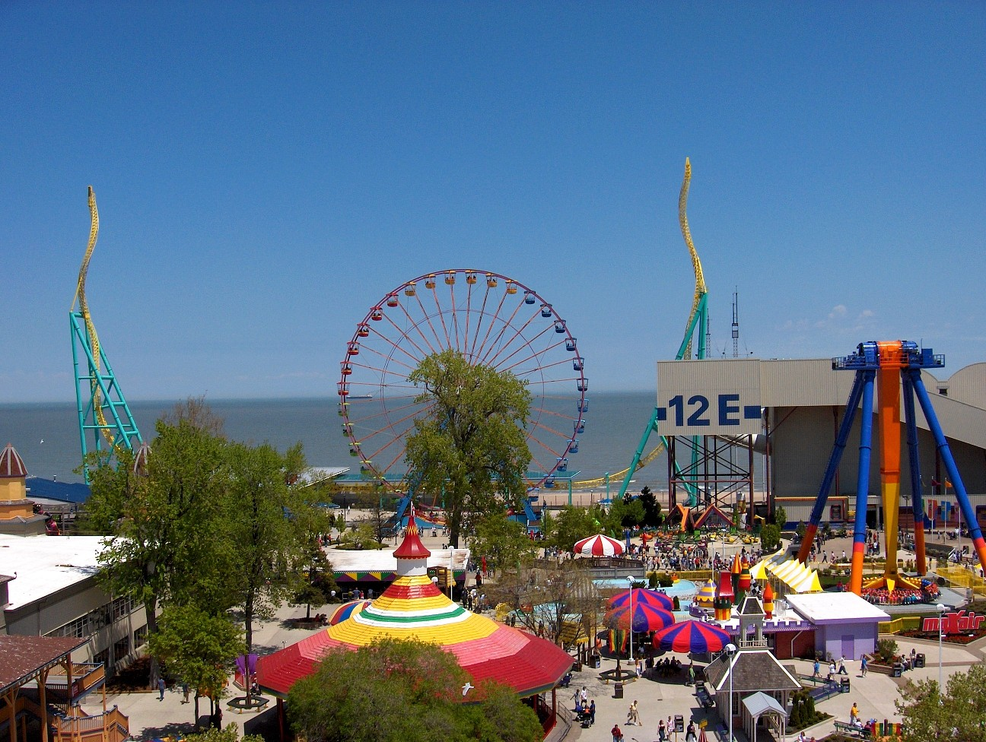
Vision as a source of semantic information
amusement park
sky
Objects Activities Scenes Locations Text / writing Faces Gestures Motions Emotions…
The Wicked Twister
Cedar Point
ride
Ferris wheel
ride
12 E
Lake Erie
water
ride
tree
tree
people waiting in line
people sitting on ride umbrellas
maxair
tree
deck
carousel
bench
tree
pedestrians
Slides source: Fie Fie Li (Professor, Stanford)

Slide 9
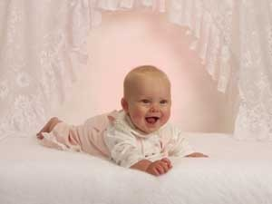

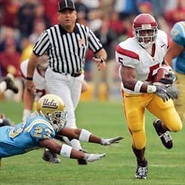
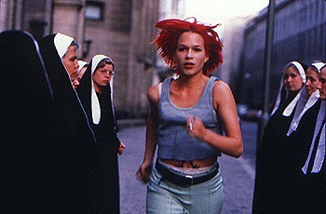
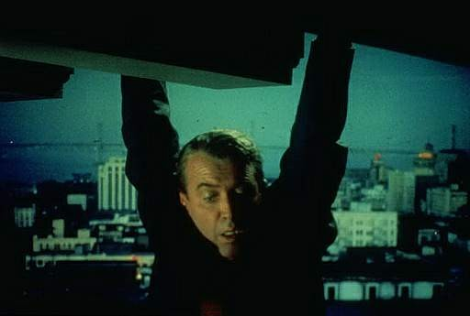


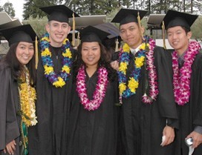
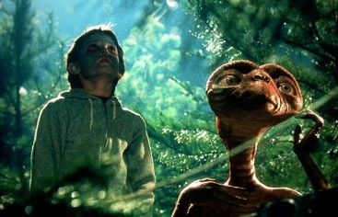
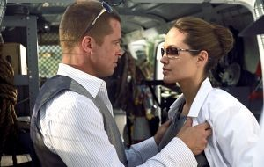

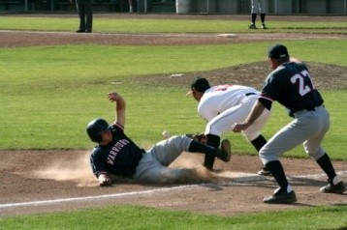






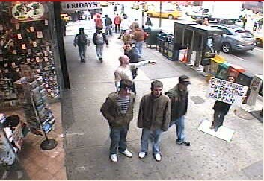
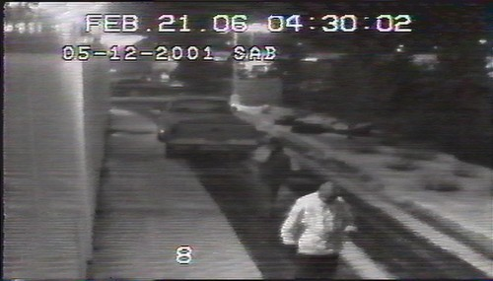
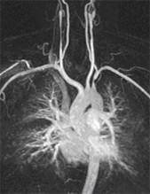
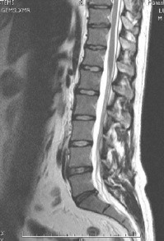
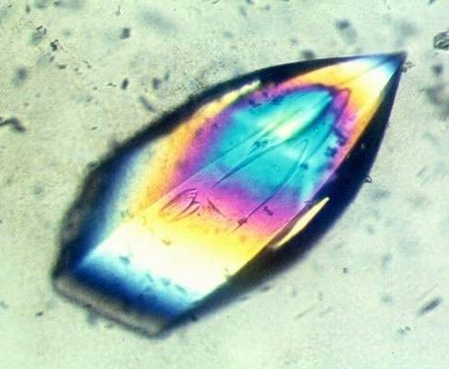
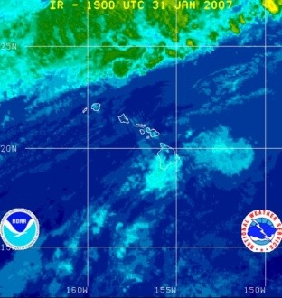
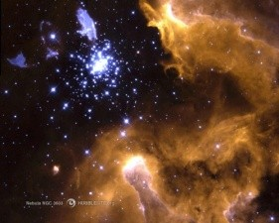
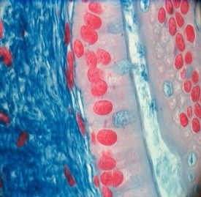
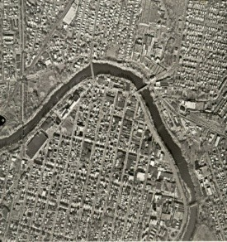
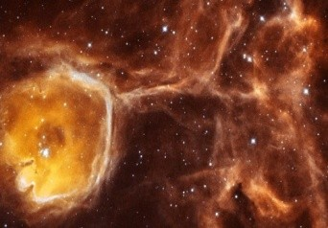
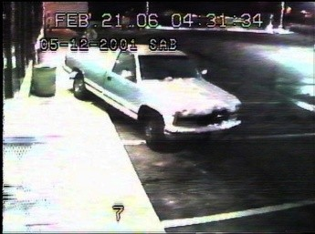
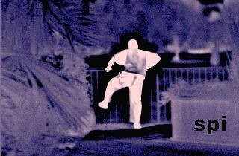
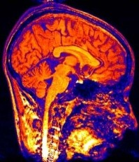
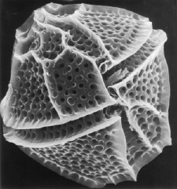
Why study computer vision?
Vision is useful: Images and video are everywhere!
Surveillance and security
Medical and scientific images
Slides source: Fie Fie Li (Professor, Stanford)

Slide 10
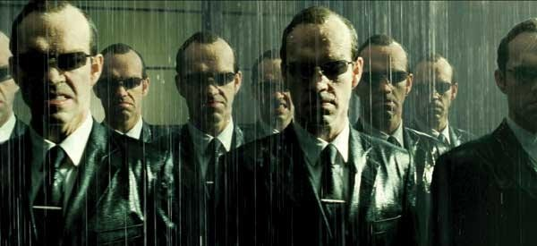
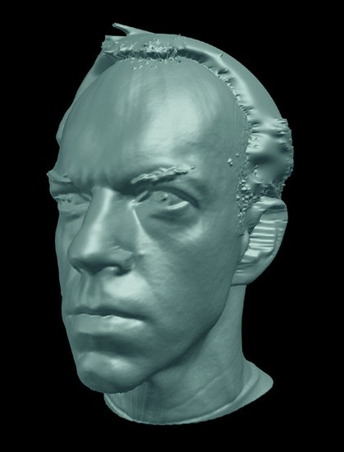

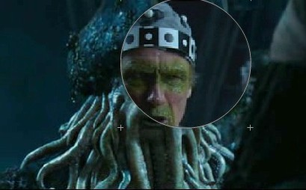
Special effects: shape and motion capture
Slides source: Fie Fie Li (Professor, Stanford)

Slide 11
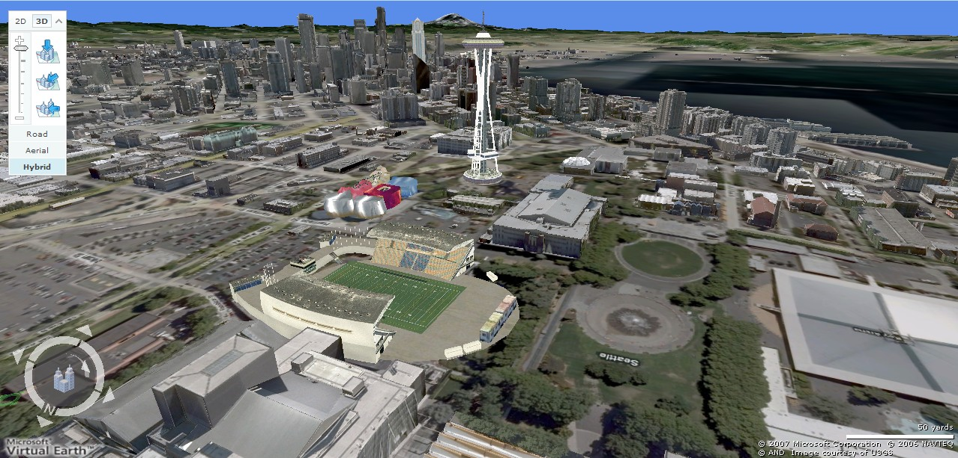
3D urban modeling
Bing maps, Google Streetview
Slides source: Fie Fie Li (Professor, Stanford)

Slide 12
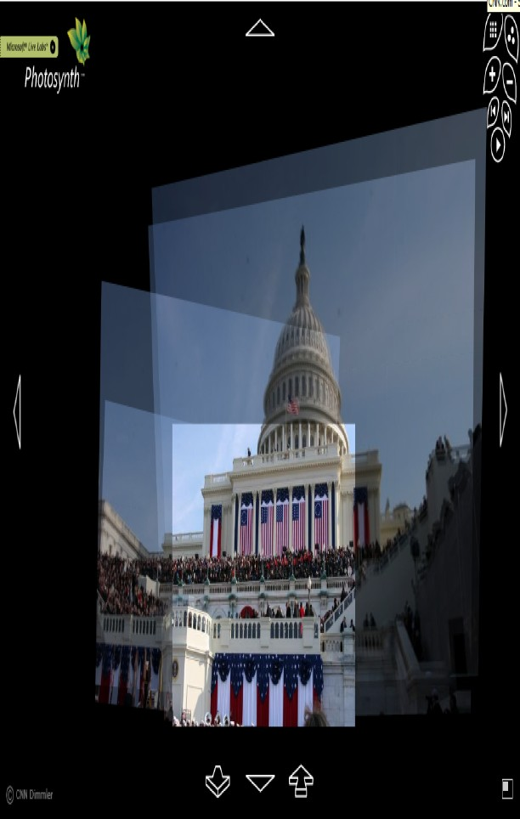
3D urban modeling: Microsoh Photosynth
http://labs.live.com/photosynth/
Slides source: Fie Fie Li (Professor, Stanford)

Slide 13

Face detection
Many new digital cameras now detect faces
– Canon, Sony, Fuji,..
Slides source: Fie Fie Li (Professor, Stanford)

Slide 14


Smile detection
Sony Cyber-shot® T70 Digital Still Camera
Slides source: Fie Fie Li (Professor, Stanford)

Slide 15

Face recognition: Apple iPhoto software
Slides source: Fie Fie Li (Professor, Stanford)

Slide 16




Biometrics
How the Afghan Girl was Identiﬁed by Her Iris Patterns
Slides source: Fie Fie Li (Professor, Stanford)

Slide 17




Biometrics
Fingerprint scanners on many new laptops, other devices
Face recognition systems now beginning to appear more widely http://www.sensiblevision.com/
Source: S. Seitz
Slides source: Fie Fie Li (Professor, Stanford)

Slide 18


Optical character recognition (OCR)
Technology to convert scanned docs to text
If you have a scanner, it probably came with OCR software
Digit recognition, AT&T labs
License plate readers
http://en.wikipedia.org/wiki/Automatic_number_plate_recognition
Slides source: Fie Fie Li (Professor, Stanford)

Slide 19



Toys and Robots
Slides source: Fie Fie Li (Professor, Stanford)

Slide 20


Mobile visual search: Google Goggles
Slides source: Fie Fie Li (Professor, Stanford)

Slide 21


Mobile visual search: iPhone Apps
Slides source: Fie Fie Li (Professor, Stanford)

Slide 22

Automotive safety
Mobileye: Vision systems in high-­‐end BMW, GM, Volvo models
– “In mid 2010 Mobileye will launch a world's ﬁrst application of full emergency braking for collision mitigation for pedestrians where vision is the key technology for detecting pedestrians.”
Slides source: Fie Fie Li (Professor, Stanford)

Slide 23

Vision in supermarkets
LaneHawk by EvolutionRobotics
“A smart camera is flush-mounted in the checkout lane, continuously watching for items.
When an item is detected and recognized, the cashier verifies the quantity of items that were found under the basket, and continues to close the transaction. The item can remain
under the basket, and with LaneHawk, you are assured to get paid for it… “
Slides source: Fie Fie Li (Professor, Stanford)

Slide 24



Vision-­‐based interaction (and games)
Sony EyeToy
Microsoft’s Kinect
Assistive technologies
Slides source: Fie Fie Li (Professor, Stanford)

Slide 25

Vision for robotics, space exploration
NASA'S Mars Exploration Rover Spirit captured this westward view from atop a low plateau where Spirit spent the closing months of 2007.
Vision systems (JPL) used for several tasks
Panorama stitching
3D terrain modeling
Obstacle detection, position tracking
For more, read “Computer Vision on Mars” by Matthies et al.
Slides source: Fie Fie Li (Professor, Stanford)

Slide 26
Let’s do some Python!
Slides source: Fie Fie Li (Professor, Stanford)

